Slide 1
wait and waitpid functions
When a process terminates, either normally or abnormally, the kernel notifies the parent by sending the SIGCHLD signal to the parent.
Because the termination of a child is an asynchronous event it can happen at any time while the parent is running this signal is the asynchronous notification from the kernel to the parent.
The parent can choose to ignore this signal, or it can provide a function that is called when the signal occurs: a signal handler.
The default action for this signal is to be ignored.

Slide 2
We need to be aware that a process that calls wait or waitpid can Block, if all of its children are still running
Return immediately with the termination status of a child, if a child has terminated and is waiting for its termination status to be fetched
Return immediately with an error, if it doesn't have any child processes
If the process is calling wait because it received the SIGCHLD signal, we expect wait to return immediately.
But if we call it at any random point in time, it can block.

Slide 3
#include <sys/wait.h>
pid_t wait(int *statloc);
pid_t waitpid(pid_t pid, int *statloc, int options);
Both return: process ID if OK, 0 or 1 on error
The differences between these two functions are as follows.
The wait function can block the caller until a child process terminates, whereas waitpid has an option that prevents it from blocking.

Slide 4
The waitpid function doesn't wait for the child that terminates first; it has a number of options that control which process it waits for.
If a child has already terminated and is a zombie, wait returns immediately with that child's status.
Otherwise, it blocks the caller until a child terminates.
If the caller blocks and has multiple children, wait returns when one terminates.
We can always tell which child terminated, because the process ID is returned by the function.

Slide 5
For both functions, the argument statloc is a pointer to an integer.
If this argument is not a null pointer, the termination status of the terminated process is stored in the location pointed to by the argument.
If we don't care about the termination status, we simply pass a null pointer as this argument.
Traditionally, the integer status that these two functions return has been defined by the implementation, with certain bits indicating the exit status (for a normal return), other bits indicating the signal number (for an abnormal return), one bit to indicate whether a core file was generated, and so on.

Slide 6
POSIX.1 specifies that the termination status is to be looked at using various macros that are defined in <sys/wait.h>.
Four mutually exclusive macros tell us how the process terminated, and they all begin with WIF.
Based on which of these four macros is true, other macros are used to obtain the exit status, signal number, and the like.

Slide 7
The interpretation of the pid argument for waitpid depends on its value:
pid == 1 Waits for any child process. In this respect, waitpid is equivalent to wait.
pid > 0 Waits for the child whose process ID equals pid.
pid == 0 Waits for any child whose process group ID equals that of the calling process.
pid < 1 Waits for any child whose process group ID equals the absolute value of pid.

Slide 8
The waitpid function returns the process ID of the child that terminated and stores the child's termination status in the memory location pointed to by statloc.
With wait, the only real error is if the calling process has no children.
With waitpid, however, it's also possible to get an error if the specified process or process group does not exist or is not a child of the calling process.

Slide 9
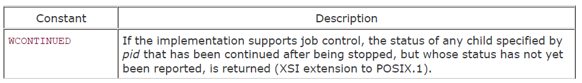
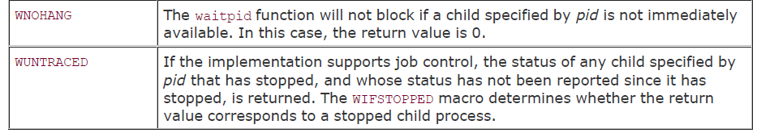
The options argument lets us further control the operation of waitpid. This argument is either 0 or is constructed from the bitwise OR of the constants

Slide 10
The waitpid function provides three features that aren't provided by the wait function.
The waitpid function lets us wait for one particular process, whereas the wait function returns the status of any terminated child.
The waitpid function provides a nonblocking version of wait. There are times when we want to fetch a child's status, but we don't want to block.
3. The waitpid function provides support for job control with the WUNtrACED and WCONTINUED options.

Slide 11
Environment
Each program is also passed an environment list.
Like the argument list, the environment list is an array of character pointers, with each pointer containing the address of a null terminated C string.
The address of the array of pointers is contained in the global variable environ:
extern char **environ;
For example, if the environment consisted of five strings, it could look like the figure in next slide.
Here we explicitly show the null bytes at the end of each string.
We'll call environ the environment pointer, the array of pointers the environment list, and the strings they point to the environment strings.

Slide 12
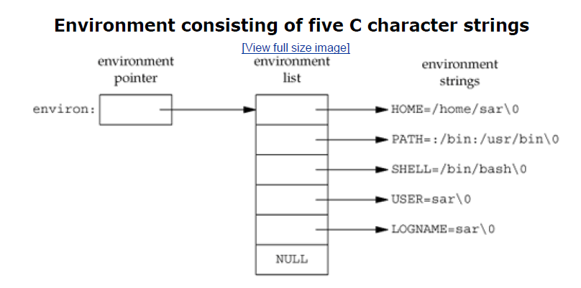

Slide 13
exec functions
When a process calls one of the exec functions, that process is completely replaced by the new program, and the new program starts executing at its main function.
The process ID does not change across an exec, because a new process is not created; exec merely replaces the current process its text, data, heap, and stack segments with a brand new program from disk.

Slide 14
There are six different exec functions
These six functions round out the UNIX System process control primitives.
With fork, we can create new processes; and with the exec functions, we can initiate new programs.
The exit function and the wait functions handle termination and waiting for termination.
These are the only process control primitives we need.

Slide 15
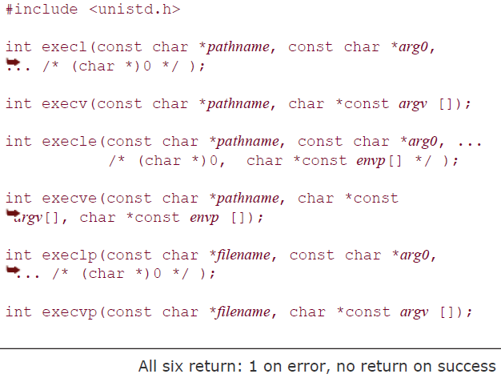

Slide 16
The first difference in these functions is that the first four take a pathname argument, whereas the last two take a filename argument.
When a filename argument is specified If filename contains a slash, it is taken as a pathname. Otherwise, the executable file is searched for in the directories specified by the PATH environment variable.
EG: PATH=/bin:/usr/bin:/usr/local/bin/:.
specifies four directories to search. The last path prefix specifies the current directory.

Slide 17
If either execlp or execvp finds an executable file using one of the path prefixes, but the file isn't a machine executable that was generated by the link editor, the function assumes that the file is a shell script and tries to invoke /bin/sh with the filename as input to the shell.

Slide 18
The next difference concerns the passing of the argument list (l stands for list and v stands for vector).
The functions execl, execlp, and execle require each of the command-line arguments to the new program to be specified as separate arguments.
We mark the end of the arguments with a null pointer.
For the other three functions (execv, execvp, and execve), we have to build an array of pointers to the arguments, and the address of this array is the argument to these three functions.
char *arg0, char *arg1, ..., char *argn, (char *)0

Slide 19
The final difference is the passing of the environment list to the new program.
The two functions whose names end in an e (execle and execve) allow us to pass a pointer to an array of pointers to the environment strings.
The other four functions, however, use the environ variable in the calling process to copy the existing environment for the new program.

Slide 20
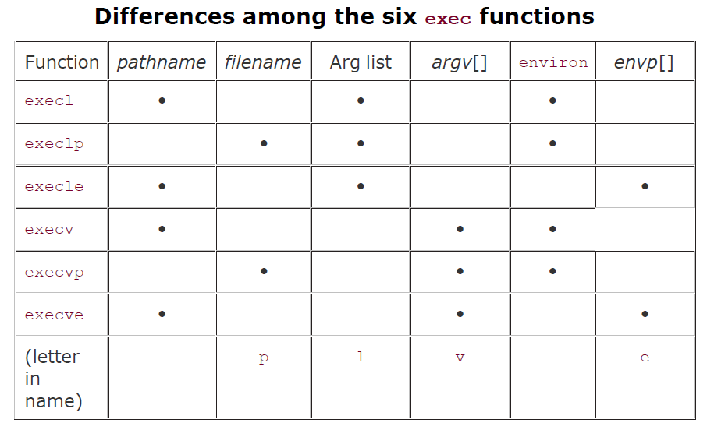

Slide 21
after an exec, but the new program inherits additional properties from the calling process:
Process ID and parent process ID
Real user ID and real group ID
Supplementary group IDs
Process group ID
Session ID
Controlling terminal
Time left until alarm clock
Current working directory
Root directory
File mode creation mask
File locks
Process signal mask
Pending signals
Resource limits
Values for tms_utime, tms_stime, tms_cutime, tms_cstime

Slide 22
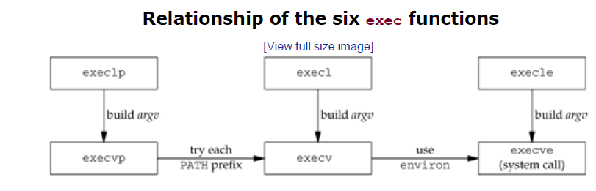

Slide 23
system function
It is convenient to execute a command string from within a program. For example, assume that we want to put a time-and-date stamp into a certain file.
system("date > file");
#include <stdlib.h>
int system(const char *cmdstring);
Returns: (see below)
If cmdstring is a null pointer, system returns nonzero only if a command processor is available.
This feature determines whether the system function is supported on a given operating system.
Under the UNIX System, system is always available.

Slide 24
Because system is implemented by calling fork, exec, and waitpid, there are three types of return values.
1. If either the fork fails or waitpid returns an error other than EINTR, system returns 1 with errno set to indicate the error.
2. If the exec fails, implying that the shell can't be executed, the return value is as if the shell had executed exit(127).
3. Otherwise, all three functions fork, exec, and waitpid succeed, and the return value from system is the termination status of the shell, in the format specified for waitpid.

